Slide 1
Assignment Two
Data Structures and Object-Oriented Programming
Instructor: Sai-Keung Wong
National Yang Ming Chiao Tung University

Slide 2
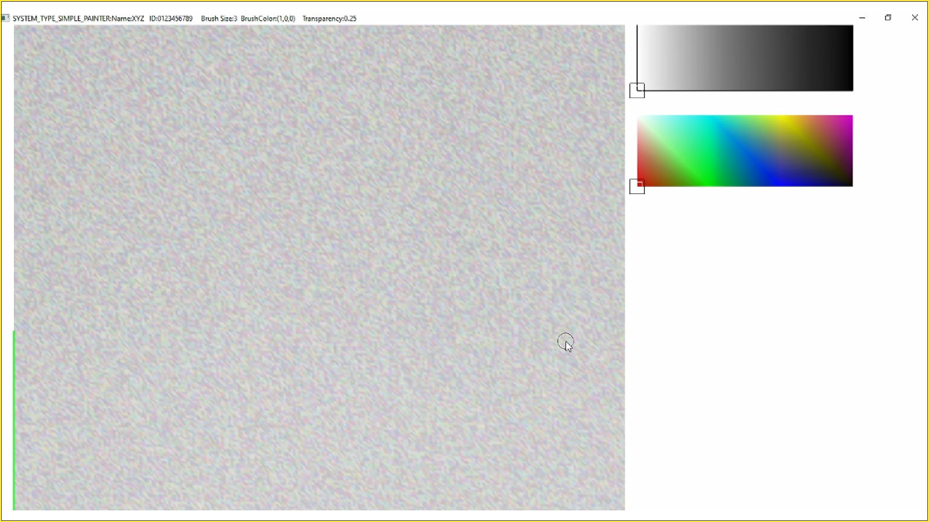
Top bar
Canvas
Color
Palette
Transparency
control
Brush
Mouse
cursor

Slide 3
Drag this icon to change transparency value
Top bar
Drag this icon to change color
Canvas
Color
Palette
Transparency
control
Brush
Mouse
cursor

Slide 4
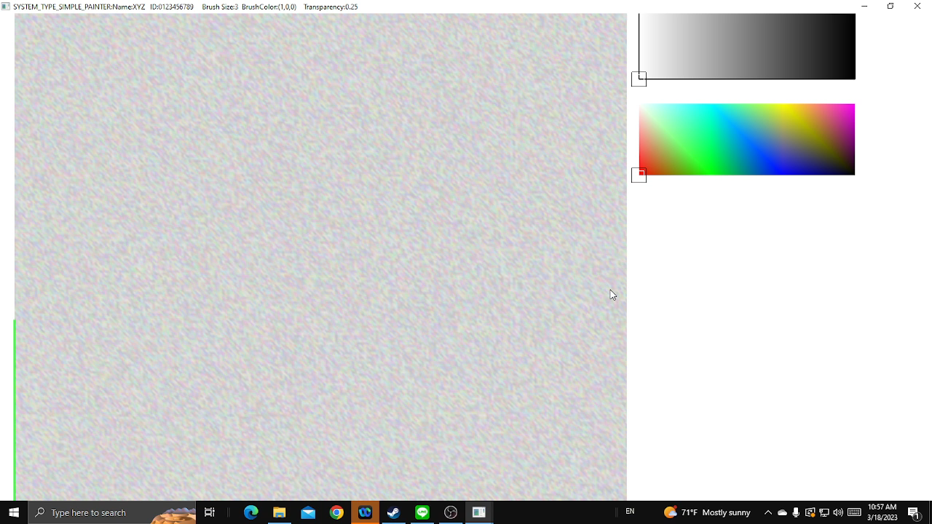
Play video
Use the mouse and the keyboard to control.
Press the left mouse button while moving the mouse to draw.
You can change the brush size and transparency.

Slide 5
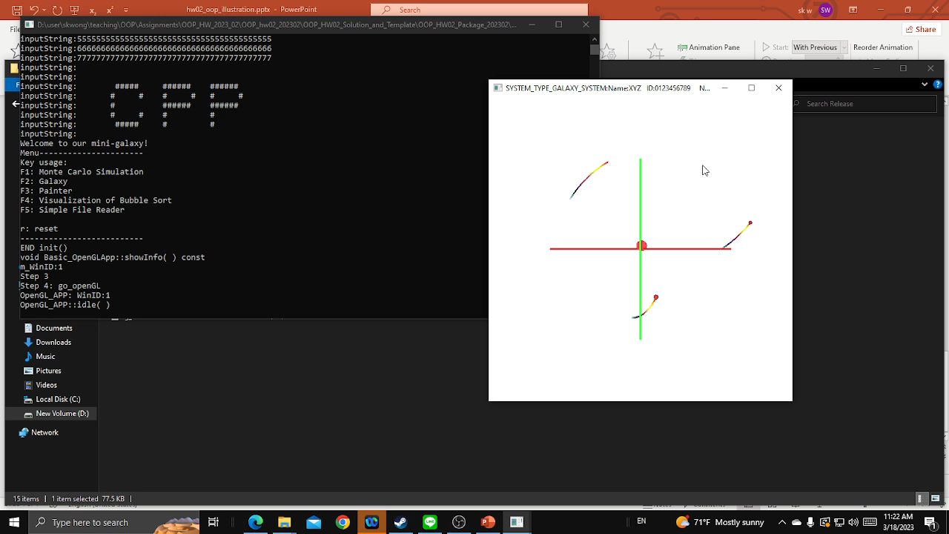
Play video
The program works well even though the brush is at the boundary of the canvas.

Slide 6
Thank you
Data Structures and Object-Oriented Programming
Instructor: Sai-Keung Wong
National Yang Ming Chiao Tung University

